Slide 1

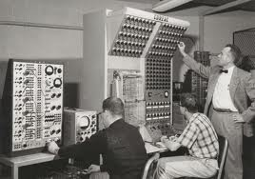
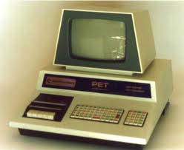
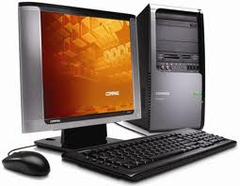
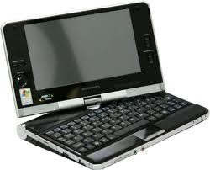
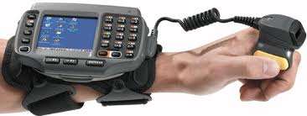

Slide 2
First generation computers
(1940-1956)
The first computers used vacuum tubes for circuitry and magnetic drums for memory.
They were often enormous and taking up entire room.
First generation computers relied on machine language.
. They were very expensive to operate and in addition to using a great deal of electricity, generated a lot of heat, which was often the cause of malfunctions.
The UNIVAC and ENIAC computers are examples of first-generation computing devices.

Slide 3

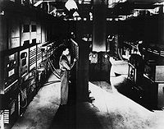
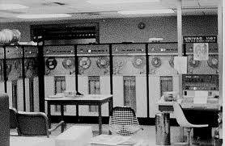
First generation computers

Slide 4
Second generation computers
(1956-1963)
Transistors replaced vacuum tubes and ushered in the second generation of computers.
Second-generation computers moved from cryptic binary machine language to symbolic.
High-level programming languages were also being developed at this time, such as early versions of COBOL and FORTRAN.
These were also the first computers that stored their instructions in their memory.

Slide 5
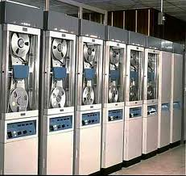
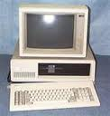
Second generation computers

Slide 6
Third generation computers
(1964-1971)
The development of the integrated circuit was the hallmark of the third generation of computers.
Transistors were miniaturized and placed on siliconchips, called semiconductors.
Instead of punched cards and printouts, users interacted with third generation computers through keyboards and monitors and interfaced with an operating system.
Allowed the device to run many different applications at one time.

Slide 7
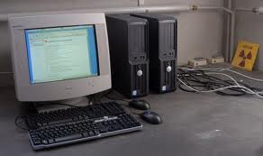
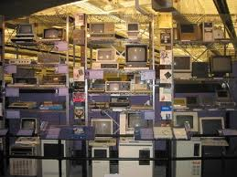
Third generation computers

Slide 8
Fourth generation computers
(1971-present)
The microprocessor brought the fourth generation of computers, as thousands of integrated circuits were built onto a single silicon chip.
The Intel 4004 chip, developed in 1971, located all the components of the computer.
From the central processing unit and memory to input/output controls—on a single chip.
. Fourth generation computers also saw the development of GUIs, the mouse and handheld devices.

Slide 9
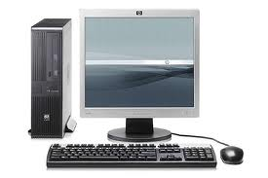
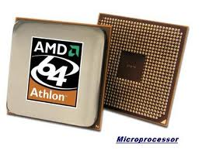
Fourth generation computers

Slide 10
Fifth generation computers
(present and beyond)
Fifth generation computing devices, based on artificial intelligence.
Are still in development, though there are some applications, such as voice recognition.
The use of parallel processing and superconductors is helping to make artificial intelligence a reality.
The goal of fifth-generation computing is to develop devices that respond to natural language input and are capable of learning and self-organization.

Slide 11
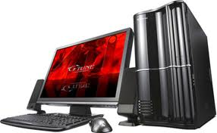
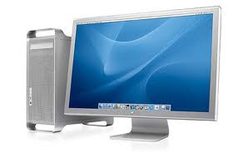
Fifth generation computers

